Slide 1


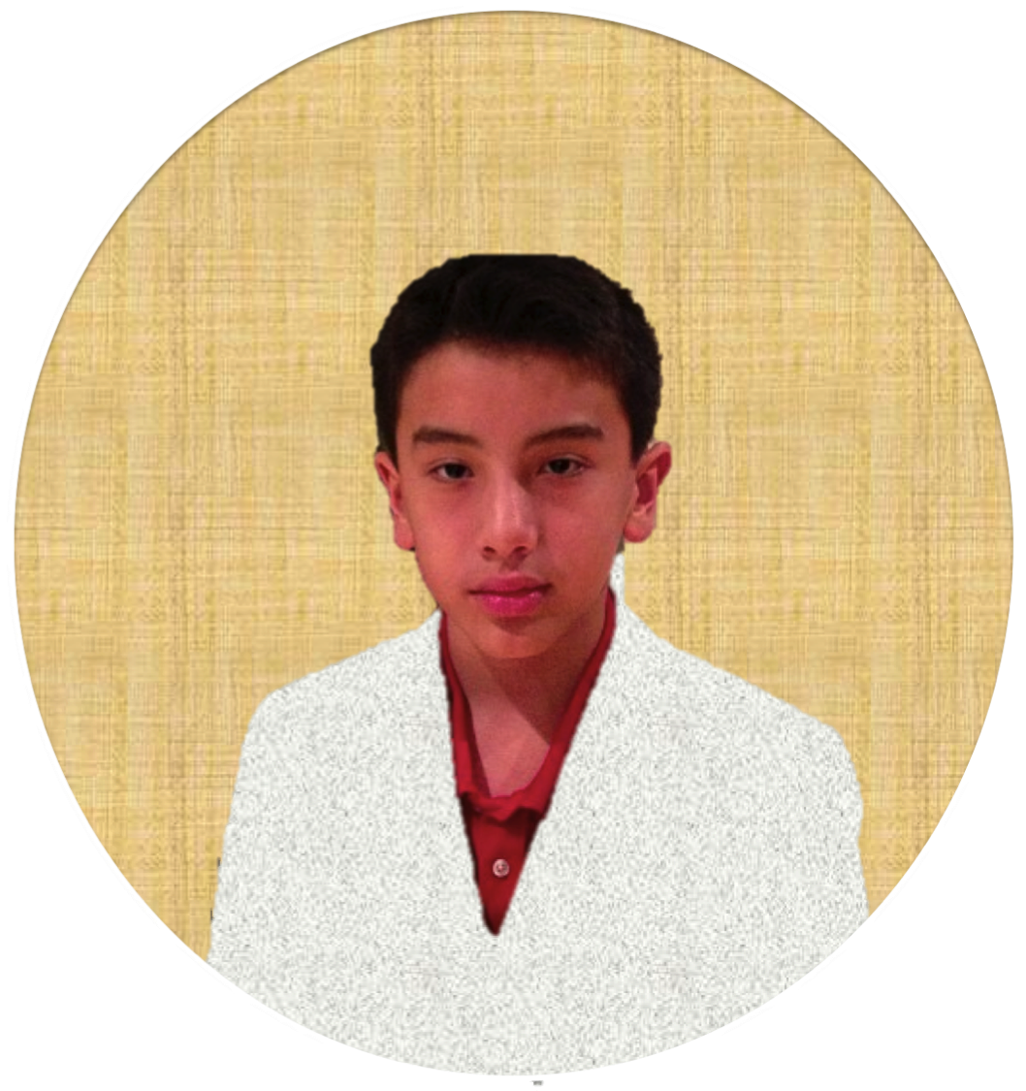


Slide 2
Welcome

Slide 3

Gi-OS
1.2
Jeffery’s Mansion
Stat Board
Safari
Care.org Project
Sun Pinnacle
City Project
Mail
Science OS
Project
Gio’s Account

Slide 4
Jeffery’s Mansion
Stat Board
Safari
Care.org Project
Sun Pinnacle
City Project
Mail
Science OS
Project
Log Off
Exit

Slide 5
Gi-OS
1.2
Jeffery’s Mansion
Stat Board
Safari
Care.org Project
Sun Pinnacle
City Project
Mail
Science OS
Project
Guest’s Account

Slide 6
Jeffery’s Mansion
Stat Board
Safari
Care.org Project
Sun Pinnacle
City Project
Mail
Science OS
Project
Log Off
Exit

